Slide 1
Mitochondrion
Lachlan D'Souza

Slide 2
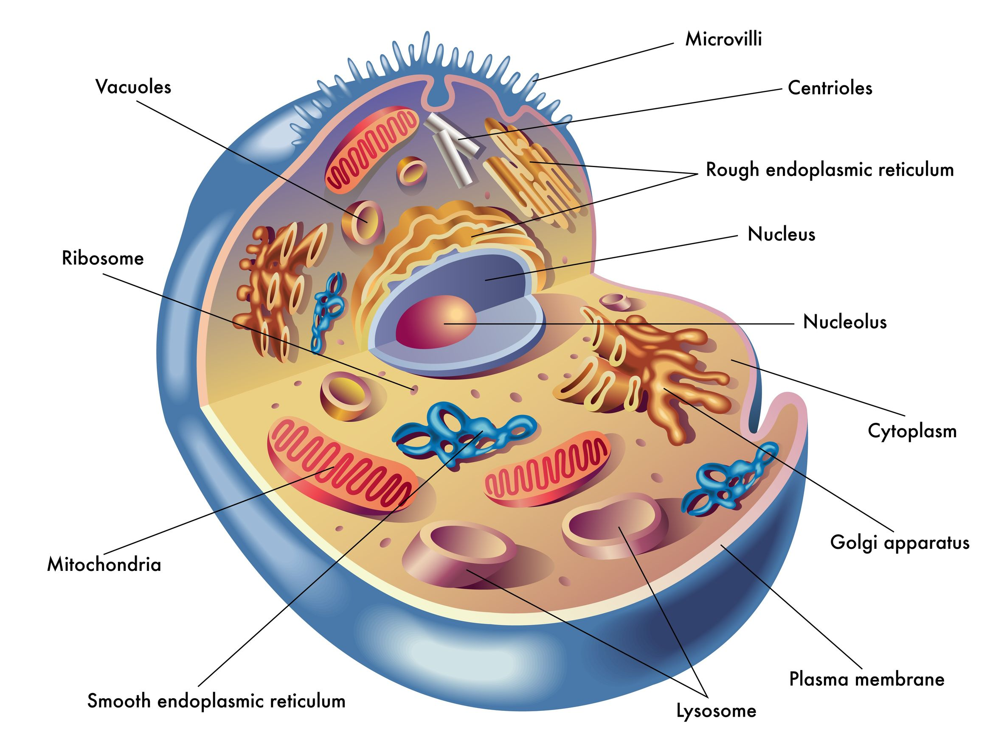
Introduction the Mitochondrion
The Mitochondrion Is an organelle that acts as provision of energy. This is because the Mitochondrion helps in the conversion of energy substrates (The macronutrients we obtain through consumption of food) into chemical energy (ATP) which provides a sustainable source of nourishment to run cell functions and health. The structure allows these processes to work effectively.
Mitochondrion in the cell

Slide 3
Functions
The Mitochondrion is a cytoplasmic organelle, of which helps in a variety of chemical metabolic functions necessary for cell survival. The mitochondrion is often regarded as the powerhouse of the cell or a power plant, as it produces chemical energy from molecules (sugar) sent to the Mitochondrion (Through food we ingest, nutrients), which are processed into charged molecules. Then Is combined with oxygen to produce ATP molecules – Know as Oxidative Phosphorylation (More information of slide 6).
Maintain proper concentration of calcium ions within the cell.
Helps in the process of apoptosis (Programmed cell death)

Slide 4
Structure
The Mitochondrion have two membranes with different phospholipid and protein configurations (The inner and outer membrane).
The outer-membrane is composed of phospholipid bilayers which possesses proteins called porins, these porins act as aqueous channels that allow smaller molecules to passively enter into the mitochondrion (such as sugars and ions). The outer-membrane also consists of transport proteins called 'TOMMs' (Translocase of the outer mitochondrial membrane) which transports larger molecules into the mitochondrion.
The inner-membrane is where the processes of ATP synthesis occurs. The inner-membrane folds on itself creating the crista or cristae for plural. This increases the surface area of the inner-membrane allowing the process of Oxidative Phosphorylation to proceed optimally and efficiently. Inside the cristae lies the matrix. Inside the matrix possesses circular loops of genetic material (Mitochondrial DNA) because the mitochondrion has its own DNA, It allows the Mitochondrion to replicate itself, and synthesis its own RNA and proteins. The space between the inner and outer membrane is called 'Intermembrane space' there are hydrogen protons floating around in this space, needed for ATP synthesis.

Slide 5
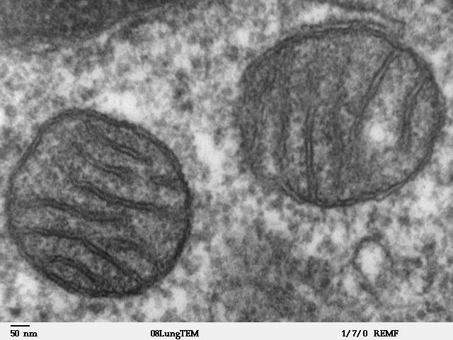
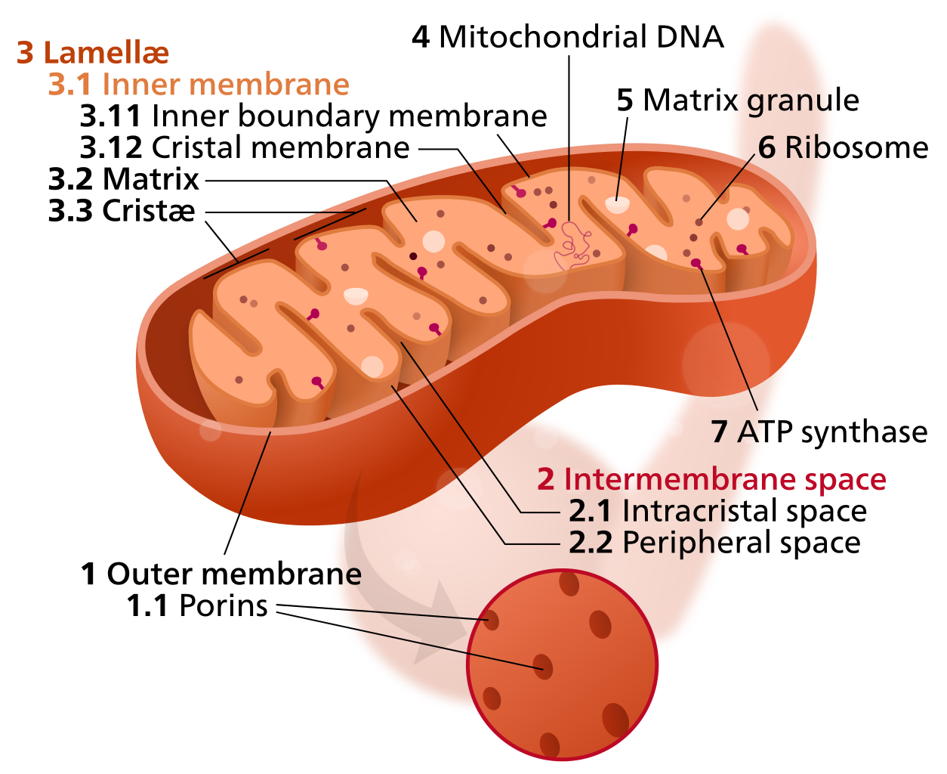
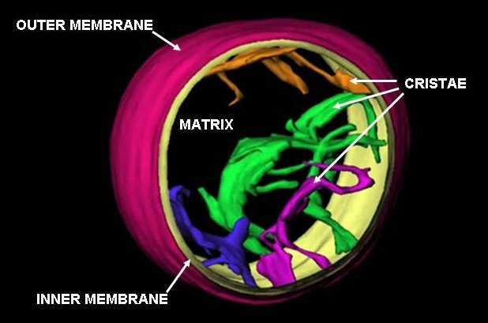
Visual Depiction of the Mitochondrion

Slide 6
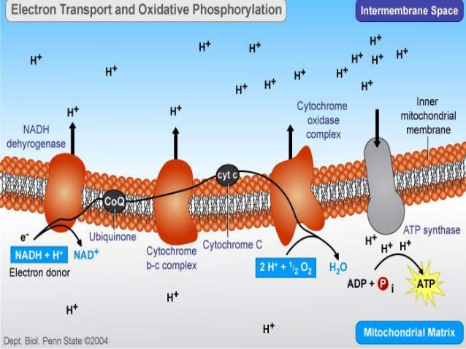
Oxidative Phosphorylation
Electrons are obtained through electron carriers (NADH+ and FADH2) then travel through the complexes (Complex 1,2,3,4) across the electron transport chain, of which then reaches the final electron acceptor (Oxygen). These electrons help reduce oxygen to form H2O. While this process Is carried out, hydrogen protons are being pumped out of the matrix into the intermembrane space, then flows down the electrochemical gradient through the ATP synthase to create ATP. This process is necessary to produce ATP.

Slide 7
Facts
The mitochondria can change shape and move around the cell when required.
If the cell has an abundance of energy, and needs less, the mitochondria will die.
Mitochondria are found in both
Plants and Animal cells both have mitochondria (Eukaryotic cells)
Mitochondrial disease can lead to loss of motor control, gastro-intestinal disorders, growth disorders, cardiac disease, liver disease, respiratory illness, seizures, visual and hearing loss, lactic acidosis and immune weakness.

Slide 8
Referencing
Mitochondria - Google Search. 2017. Mitochondria - Google Search. [ONLINE] Available at: https://www.google.com.au/search?q=Mitochondria&source=lnms&tbm=isch&sa=X&ved=0ahUKEwi99NG60ZnUAhXONpQKHajTCFYQ_AUICigB&biw=1097&bih=578#imgrc=JL9S72Rm3DvPDM:. [Accessed 31 May 2017].
From Bench to Bedside. 2017. Introduction to Mitochondria Part 1 | From Bench to Bedside. [ONLINE] Available at: https://frombenchtobedside.wordpress.com/2014/03/03/introduction-to-mitochondria-part-1/. [Accessed 31 May 2017].
Mitochondrion - Wikipedia. 2017. Mitochondrion - Wikipedia. [ONLINE] Available at: https://en.wikipedia.org/wiki/Mitochondrion#/media/File:MitochondrionCAM.jpg. [Accessed 31 May 2017].
Khan Academy. 2017. Oxidative phosphorylation | Biology (article) | Khan Academy. [ONLINE] Available at: https://www.khanacademy.org/science/biology/cellular-respiration-and-fermentation/oxidative-phosphorylation/a/oxidative-phosphorylation-etc. [Accessed 31 May 2017].
Mitochondrion - Wikipedia. 2017. Mitochondrion - Wikipedia. [ONLINE] Available at: https://en.wikipedia.org/wiki/Mitochondrion#/media/File:Mitochondrion_mini.svg. [Accessed 31 May 2017].
Oxidative phosphorylation. 2017. Oxidative phosphorylation. [ONLINE] Available at: https://www.slideshare.net/sadaffarooq395/oxidative-phosphorylation-29905346. [Accessed 31 May 2017].
Mitochondria, Function of Mitochondria, Structure of Mitochondria | Biology@TutorVista.com. 2017. Mitochondria, Function of Mitochondria, Structure of Mitochondria | Biology@TutorVista.com. [ONLINE] Available at: http://biology.tutorvista.com/animal-and-plant-cells/mitochondria.html. [Accessed 31 May 2017].
Molecular Expressions Cell Biology: Mitochondria. 2017. Molecular Expressions Cell Biology: Mitochondria. [ONLINE] Available at: https://micro.magnet.fsu.edu/cells/mitochondria/mitochondria.html. [Accessed 31 May 2017].
Bright Hub. 2017. What Is the Function and Structure of Mitochondria?. [ONLINE] Available at: http://www.brighthub.com/science/genetics/articles/24289.aspx. [Accessed 31 May 2017].
Cultivate Your Nature. 2017. mitochondria | Cultivate Your Nature. [ONLINE] Available at: https://cultivateyournature.com/tag/mitochondria/. [Accessed 31 May 2017].

